Slide 1

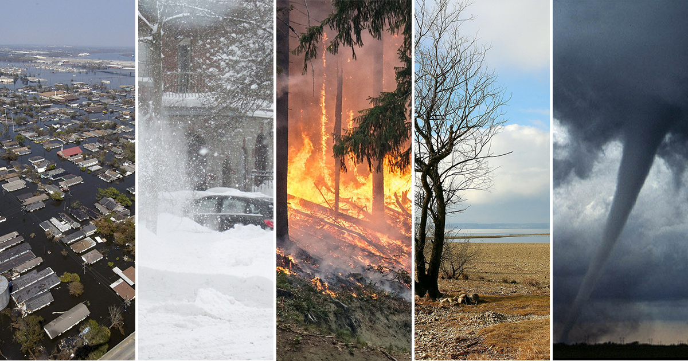

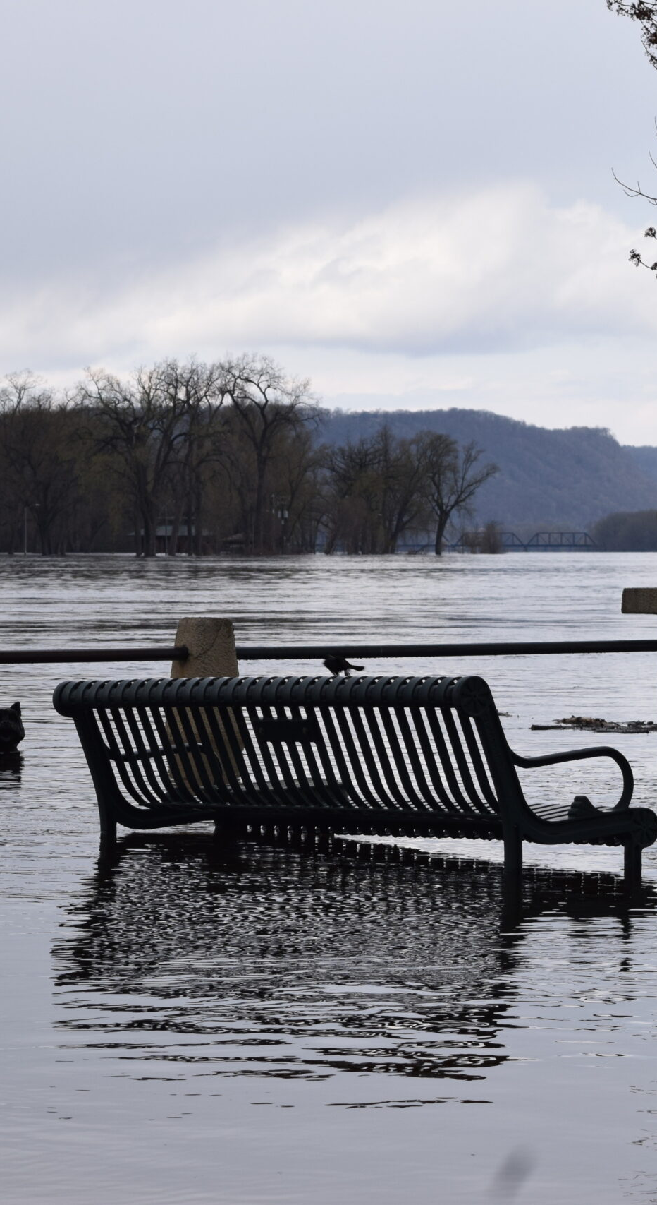
Emergency Management
This Photo by Unknown Author is licensed under CC BY-SA-NC
La Crosse County​

Slide 2
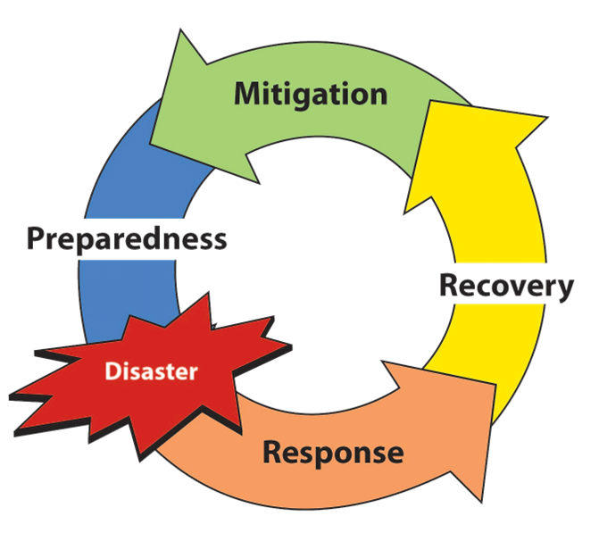
The Disaster Cycle
What does Emergency Management do?
Manage activities across all four phases of the disaster cycle.
During the Preparedness Phase Emergency Managers prepare plans and procedures for responding to hazardous events.
During the Response Phase prioritize and coordinate resources
During the Recovery Phase we conduct damage assessments, prioritize the reconstruction of critical infrastructures and the rehabilitation of the community
During the Mitigation Phase we create and implement projects and policies that reduce vulnerability
Notes:
During the Preparedness Phase Emergency Managers prepare plans and procedures for responding to hazardous events
During the Response Phase, we conduct damage assessments and coordinate resources
During the Recovery Phase we prioritize the reconstruction of critical infrastructures and the rehabilitation of the community

Slide 3
Four Phases Continued…
MITIGATION
Prevent an emergency
Reduce the chance of an emergency occurring
Reduce the damaging effects of unavoidable hazards
PREPAREDNESS
Develop plans to ensure an effective, efficient response
Take steps to minimize damage
Recruit and train personnel
Equip and staff the Emergency Operations Center
RESPONSE
Provide emergency assistance to casualties
Provide search and rescue
Provide mass care and shelter
Provide medical care
Reduce secondary damage
RECOVERY
Return to normal after an emergency
Redevelopment grants and loans
Legal assistance
Community planning

Slide 4
What is a hazard?​
A hazard is anything that can harm human life, property, or the environment​
Emergency
Disaster
Catastrophe
Levels to hazardous events​
Emergency: Typically, smaller in scale and are handled by first responders or local emergency managers
Disaster: Larger in scale, effecting a significant amount of people or area, and require the attention of County Emergency Management
Catastrophe: Extremely large in scale, effecting large amounts of people, usually evolving multiple cities, counties, or even states, requiring several Emergency Managers across jurisdictional boundaries​

Slide 5
Whole Community Preparedness​
Preparedness is a shared responsibility that calls for the involvement of everyone – not just the government – In preparedness efforts. By working together, everyone can help keep the nation safe from harm and help keep it resilient when struck by hazards, such as natural disaster, acts of terrorism, and pandemics
Whole Community Includes:
Individual and families, including those with access and functional needs;
Businesses;
Faith-based and community organizations;
Nonprofit groups;
Schools and academia;
Media outlets; and
All levels of government, including state, local, tribal, territorial, and federal partners
Hospitals

Slide 6
Types of Emergency Managers
Local Emergency Manager
County Emergency Manager
Tribal Emergency Manager
State Emergency Manager
​
Role
No matter the title, the emergency manager’s ultimate role is to coordinate resources to protect lives and preserve property, environmental and cultural resources through capacity building, mitigation, preparedness, training, education to ensure response to and recovery from all man-made and natural hazards that may impact their jurisdiction.

Slide 7
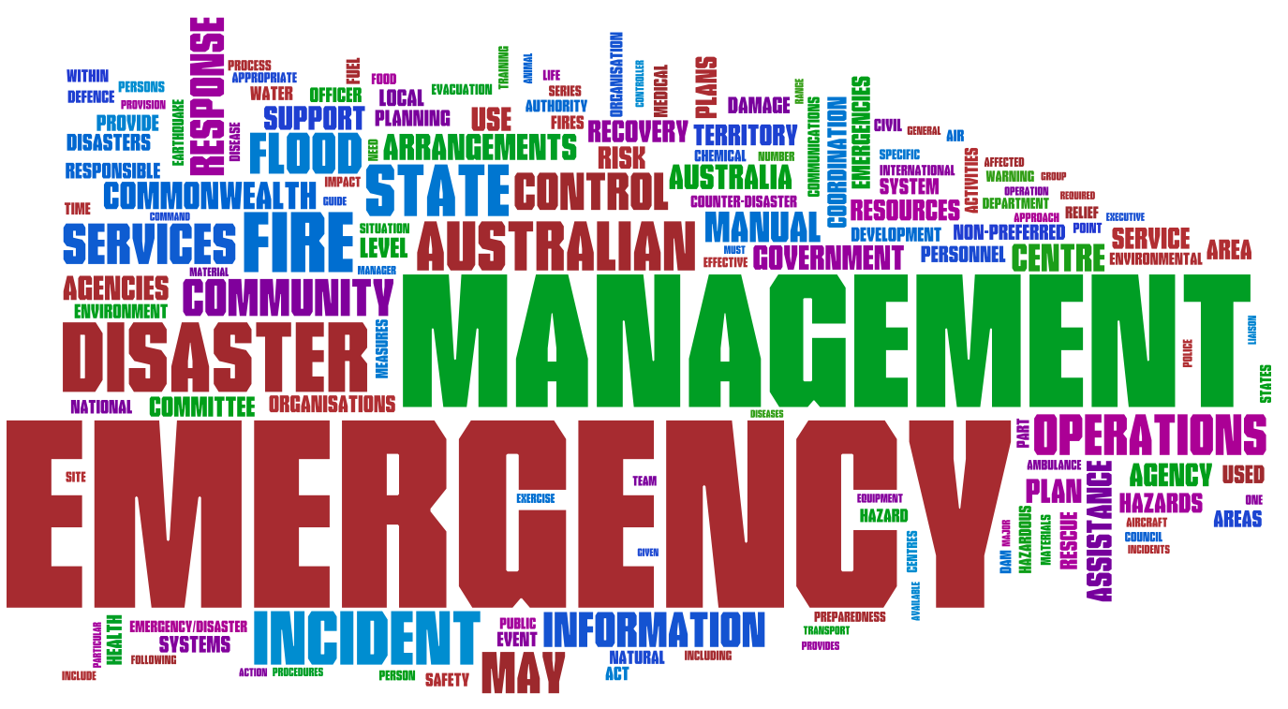
Local Emergency Manager
    The majority of emergencies and disasters are local and are handled locally by first responders and emergency managers.
    The local emergency manager has the responsibility for coordinating all components of the emergency management programs and activities for the community, including:
  Managing resources before, during, and after a major emergency or disaster.
  Conducting activities related to the key components of emergency management.
  Coordinating with all partners in the emergency management process.

Slide 8
County Emergency Managers
The head of emergency management for each county shall:
Coordinate and assist in developing city, village, and town emergency management plans within the county
Integrate the State plans with the county plan
Advise the department of military affairs of all emergency management planning in the county and submit to the adjutant general the reports that he or she requires
Direct and coordinate emergency management activities throughout the county during a state of emergency
Direct county-wide emergency management training programs and exercises.

Slide 9
County Emergency Managers
The head of emergency management for each county shall:
Coordinate with government representatives to create strategies for catastrophes like natural disasters or hazards to public health.
Examine and revise emergency plans and procedures to make sure they comply with the most recent rules and regulations.
Develop relationships with emergency response agencies to facilitate inter-agency operations in emergencies.
Design, take decisions, manage and run each stage of emergency management.
Be responsible for emergency communication and coordination with other agencies, groups and government agencies.
Powers during an emergency-
During a state of emergency declared by the governor, the head of emergency management for each local unit of government, on behalf of his or her respective local unit of government, may contract with any person to provide equipment and services on a cost basis to be used to respond to a disaster, or the imminent threat of a disaster.

Slide 10
State Emergency Management
The State Emergency Management is responsible for assisting communities by reviewing their plans and providing guidance. State Emergency Management also makes plans and assesses its capability to provide protection from large-scale, statewide disasters. State Emergency Management also has the capability to provided physical and financial resources when local or county resources are not enough.

Slide 11
La Crosse County- Emergency Plans
Municipal Disaster Plans
We currently have 67+ off-site Hazmat plans in the County
School Response Plans (K-12 and higher education)
Countywide Hazard Mitigation Plan
Countywide Basic Response Plan
15 ESF’s for the County
Family Assistance Center, Reunification, Volunteers
Mass Fatality and Mass Casualty

Slide 12

What are Grants?
Grants are money made available by the state or federal government to support specific initiatives. To receive a grant there are many requirements, specific to each grant that one must complete to apply and be accepted to receive this money. Grants can be valuable resources in emergency management and can be used for things like improvement projects that will increase resilience and limit impacts to hazards.
.

Slide 13
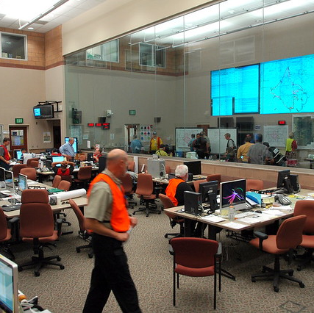
Emergency Operations Center (EOC)
During a large scale, jurisdictional incident the EOC will serve as a central location where representatives of the public and private sectors convene to make decisions, set priorities and coordinate resources for response and recovery.
This Photo by Unknown Author is licensed under CC BY-NC-ND

Slide 14
EOC Activation Levels
Level 1: Full activation – All EOC elements are activated for a major, threatening incident, such as a wildfire or significant flooding.
Level 2: Partial activation - Incident or event requires significant monitoring or resources, Additional EOC staffing from agencies, functions, and supporting organization
Level 3: Enhanced monitoring - Emergency management staff are actively monitoring any incident or events
Level 4: Normal Operations - Normal day-to-day operations, routine staffing and office hours. Off-hours emergency coverage is provided by “on call” personnel.

