Slide 1

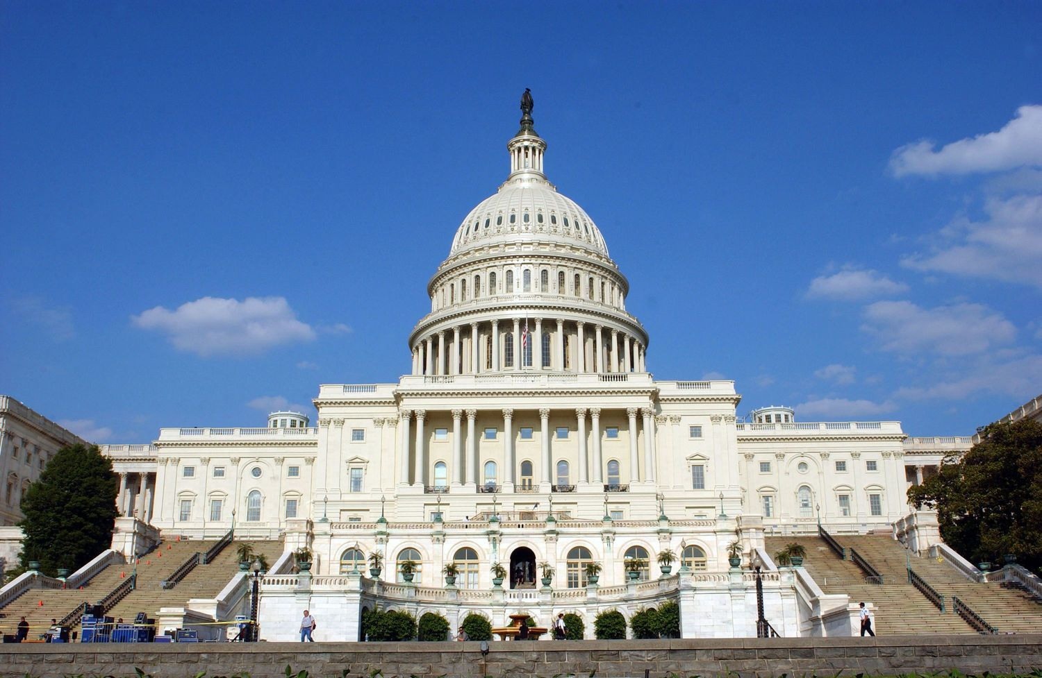

La Crosse County Human Services & the
Federal Budget

Slide 2
La Crosse County
Human Service Budget = $67 Mil
Revenue Sources
Dynamics
Other (5%)
● Stringent statutory levy caps
Local
Levy
(20%)
● Stagnant State Funding
State &
Federal
(75%)

Slide 3
Stagnant State Funding
Example
La Crosse County Human Services
Funding from Basic County Allocation
($2.8 Mil)
CPI-U Increase Since 2016 = 34 %

Slide 4
La Crosse County
Human Service Budget = $67 Mil
Revenue Sources
Dynamics
Other (5%)
● Stringent statutory levy caps
Local
Levy
(20%)
● Stagnant State Funding
State &
Federal
(75%)
● Mandates & Uncontrollable Costs

Slide 5

Out-of-Home Care Expenditures
Children & Youth
Average Cost Per Placement*
Residential Caring Centers
$4.1 Mil
● Child Protective Services (CPS)
$865 daily ($315,775 annualized)
● Youth Justice Services (YJ)
$632 daily ($230,680 annualized)
$1.5 Mil
*2025 YTD

Slide 6
La Crosse County
Human Service Budget = $67 Mil
Revenue Sources
Dynamics
Other (5%)
● Stringent statutory levy caps
Local
Levy
(20%)
● Stagnant State Funding
State &
Federal
(75%)
● Mandates & Uncontrollable Costs
● Budgetary pressures from the Federal Reconciliation Package

Slide 7
Federal Reconciliation Package
Human Services Fiscal Impacts
1. FoodShare
● Administrative Costs: Reduces the Federal Cost Share for FoodShare Administration from 50% to 25%
Loss of $12 million in Wisconsin’s current federal funding with potential impacts on counties
● Benefit Costs: Requires States to share in FoodShare benefit costs if error rates exceed certain thresholds
Potential $100 million dollar issue for the State of Wisconsin and / or county governments
2. Medicaid
● Workload Increases: Changes impacting administrative workload & frequency
of eligibility redeterminations

Slide 8
La Crosse County
Human Service Budget = $67 Mil
Revenue Sources
Dynamics
Other (5%)
● Stringent statutory levy caps
Local
Levy
(20%)
● Stagnant State Funding
State &
Federal
(75%)
● Mandates & Uncontrollable Costs
● Budgetary pressures from the Federal Reconciliation Package
● Potential secondary impacts on other County (i.e., highways, law enforcement)

Slide 9
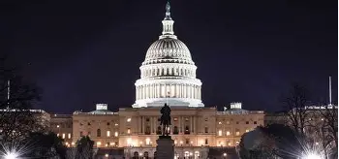
Items to Watch
In upcoming appropriations process
● Substance Abuse Block Grant
● State Opioid Response Grant
● Mental Health Block Grant

Slide 10

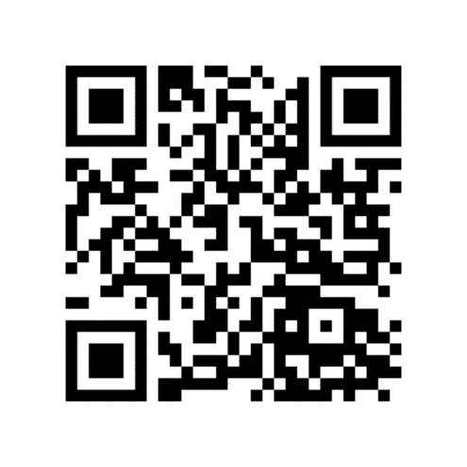
Follow our efforts at:
Pathways Home website:
Thank You!
https://lacrossecounty.org/pathwayshome
La Crosse County newsletter:

