Slide 1
2025 Budget Packet & Contracting

Slide 2

Timeline
The Budget Packet process is used to set the rates for the next contract year.
Budget packets will be emailed to vendors around the week of August 19-23.
Budget packets due back September 9, 2024.
It is possible to get an extension to the September deadline by requesting via email, but we do need a majority of contracts entered in and approved by our system by mid-November.

Slide 3
Timeline
August 19-23
Budget packets sent to vendors via email.
September 9
Budget packets due returned
Fall 2024
Contracts with 2025 rates prepared and sent to vendors for signature
January 1, 2025
2025 contracts and rates go into effect

Slide 4
CPI-U (Consummer Price Index – Urban)
Starting in 2010, we began creating 3-year contracts. This allowed an automatic CPI-U Increase, between 0% and 3%, in years 2 & 3 of the contracts and then negotiation of a base rate again in year 4.
Due to RFP’s, new services and changes to existing services, some vendors now receive 2 budget packets, Phase 1 and Phase 2 of the budget packet process.
The CPI-U amount will be released in August, based on July CPI-U numbers.

Slide 5
Phase 1
Phase 1 is the negotiation of the base rate for services in year 1 and 4, and so forth going forward. This includes a spreadsheet where you can agree to the prior year’s rate by signing it or you can fill out the enclosed budget request form, breaking out all of the expenses needed to get to your rate.
The budget packet is based on the State’s Allowable Cost Policy Manual. The goal in the end is to have the option to re-negotiate the rates every 3 years. If you feel the increases in the past haven’t been enough to cover your increased expenses, this is an important time to look at the rate and set a quality base rate.

Slide 6
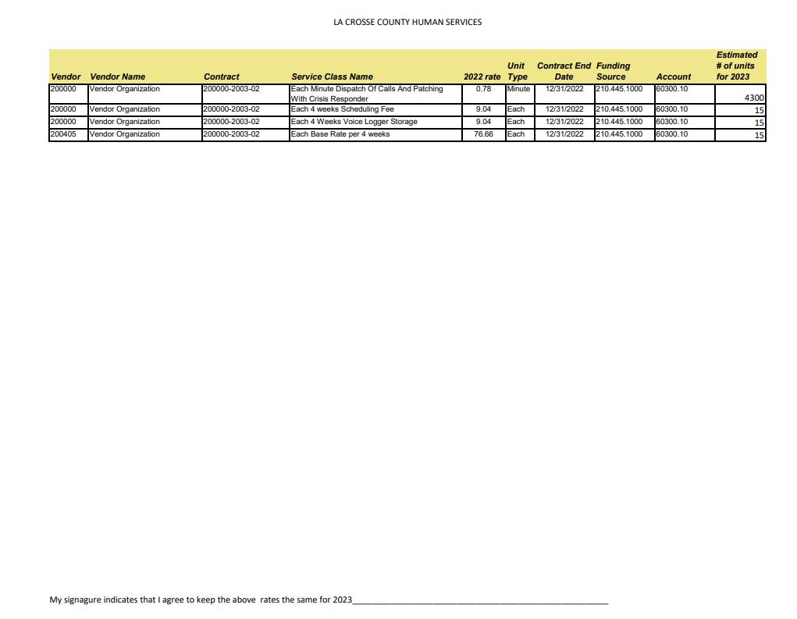

Slide 7
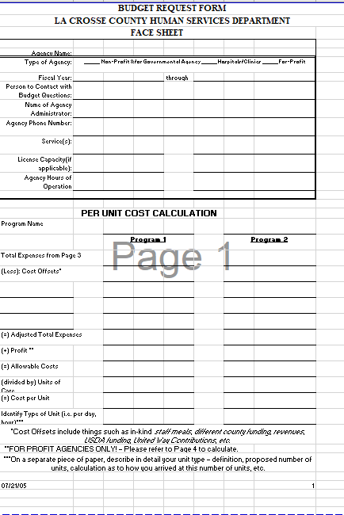
Budget Request Form
Four-tab Spreadsheet for rate consideration
Face Sheet
Salary & Fringe breakdown
Expense distribution form
Profit calculation

Slide 8
Phase 2
* Phase 2 is where the vendor receives a spreadsheet for services in years 2 & 3 listing new rates including the CPI-U increase for signature. and they sign the spreadsheet to agree to the increase. The final CPI-U will be known in mid-August, and increases are capped at a maximum of 3%.
* If a vendor feels they need to re-negotiate a rate before the 3 years is up, and they are not a part of a Request for Proposal or Preferred Provider Solicitation network, they can request a Budget Request Form. The budget request form can also be found on our website. Once that is submitted, the supervisors and managers will review that request and may contact you to discuss and negotiate before putting a final rate in the contract.

Slide 9
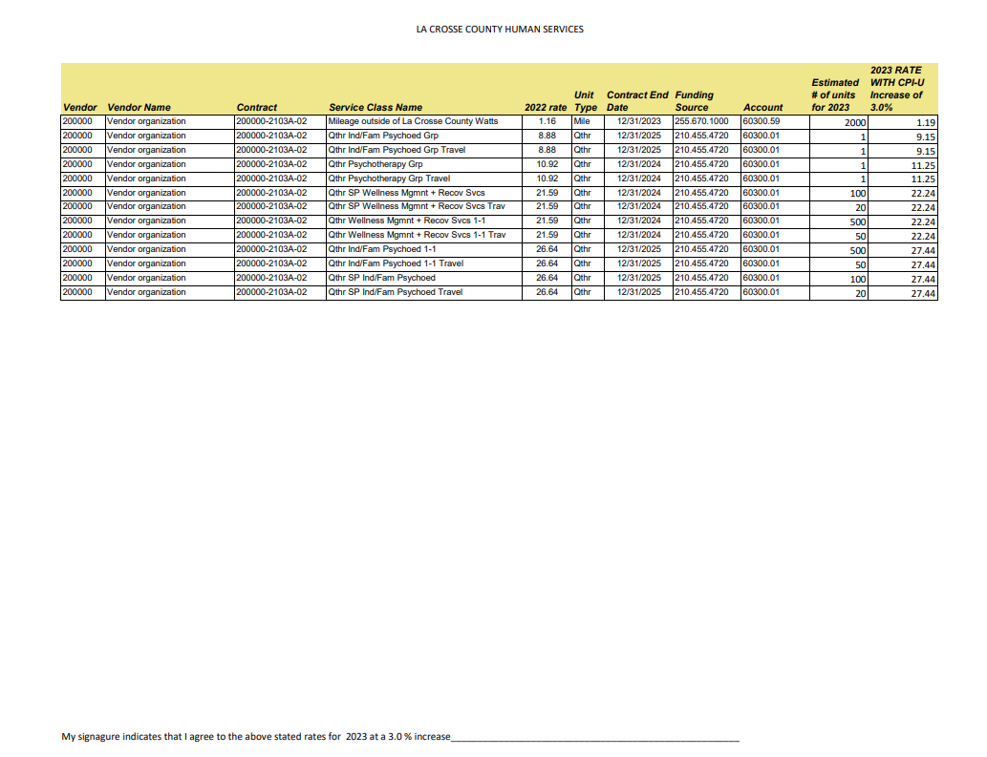

Slide 10
Items to Note
If a vendor has multiple contracts, it is possible they could receive multiple budget packets for both phases 1 and 2.
Both phases 1 and 2 also include other documents in the budget packet, such as the Room and Board Costs Sheets, if applicable.
Vendors will not receive budget packets for services where rates are non-negotiable, such as when we pay retail price and/or rates that are set by the State, including many CLTSW rates.
CCS Residential rates are also not a part of this process, since they are set by using actual cost.
Vendors who have a multi-year contract at a fixed rate will not receive a budget packet during years of the contract term.
Finally, vendors will not receive budget packets for services that are expected to go out for Request For Proposal or Preferred Provider Solicitation Process before the end of the year.

Slide 11
Items to Note
Unit Estimates
The Budget Packet spreadsheet received indicates the units of service projected by our managers and supervisors to be used for the next year. This is an estimate that is arrived at by looking at what was purchased in the last year and what the changes in programs for the next year will be.
These estimates will be used to figure your total contract amount, so please let us know if you feel these unit estimates are not accurate.
Review & Return
Budget packet spreadsheets should be reviewed for all services, unit estimates, and 2025 rates.
The spreadsheets can simply be signed and returned, via email, unless requesting a new rate via the Budget Request form.

Slide 12




Questions?
If you have any questions during this 2025 Budget Packet process, contact:
Paul Medinger
Contract Specialist
pmedinger@lacrossecounty.org

