Slide 1
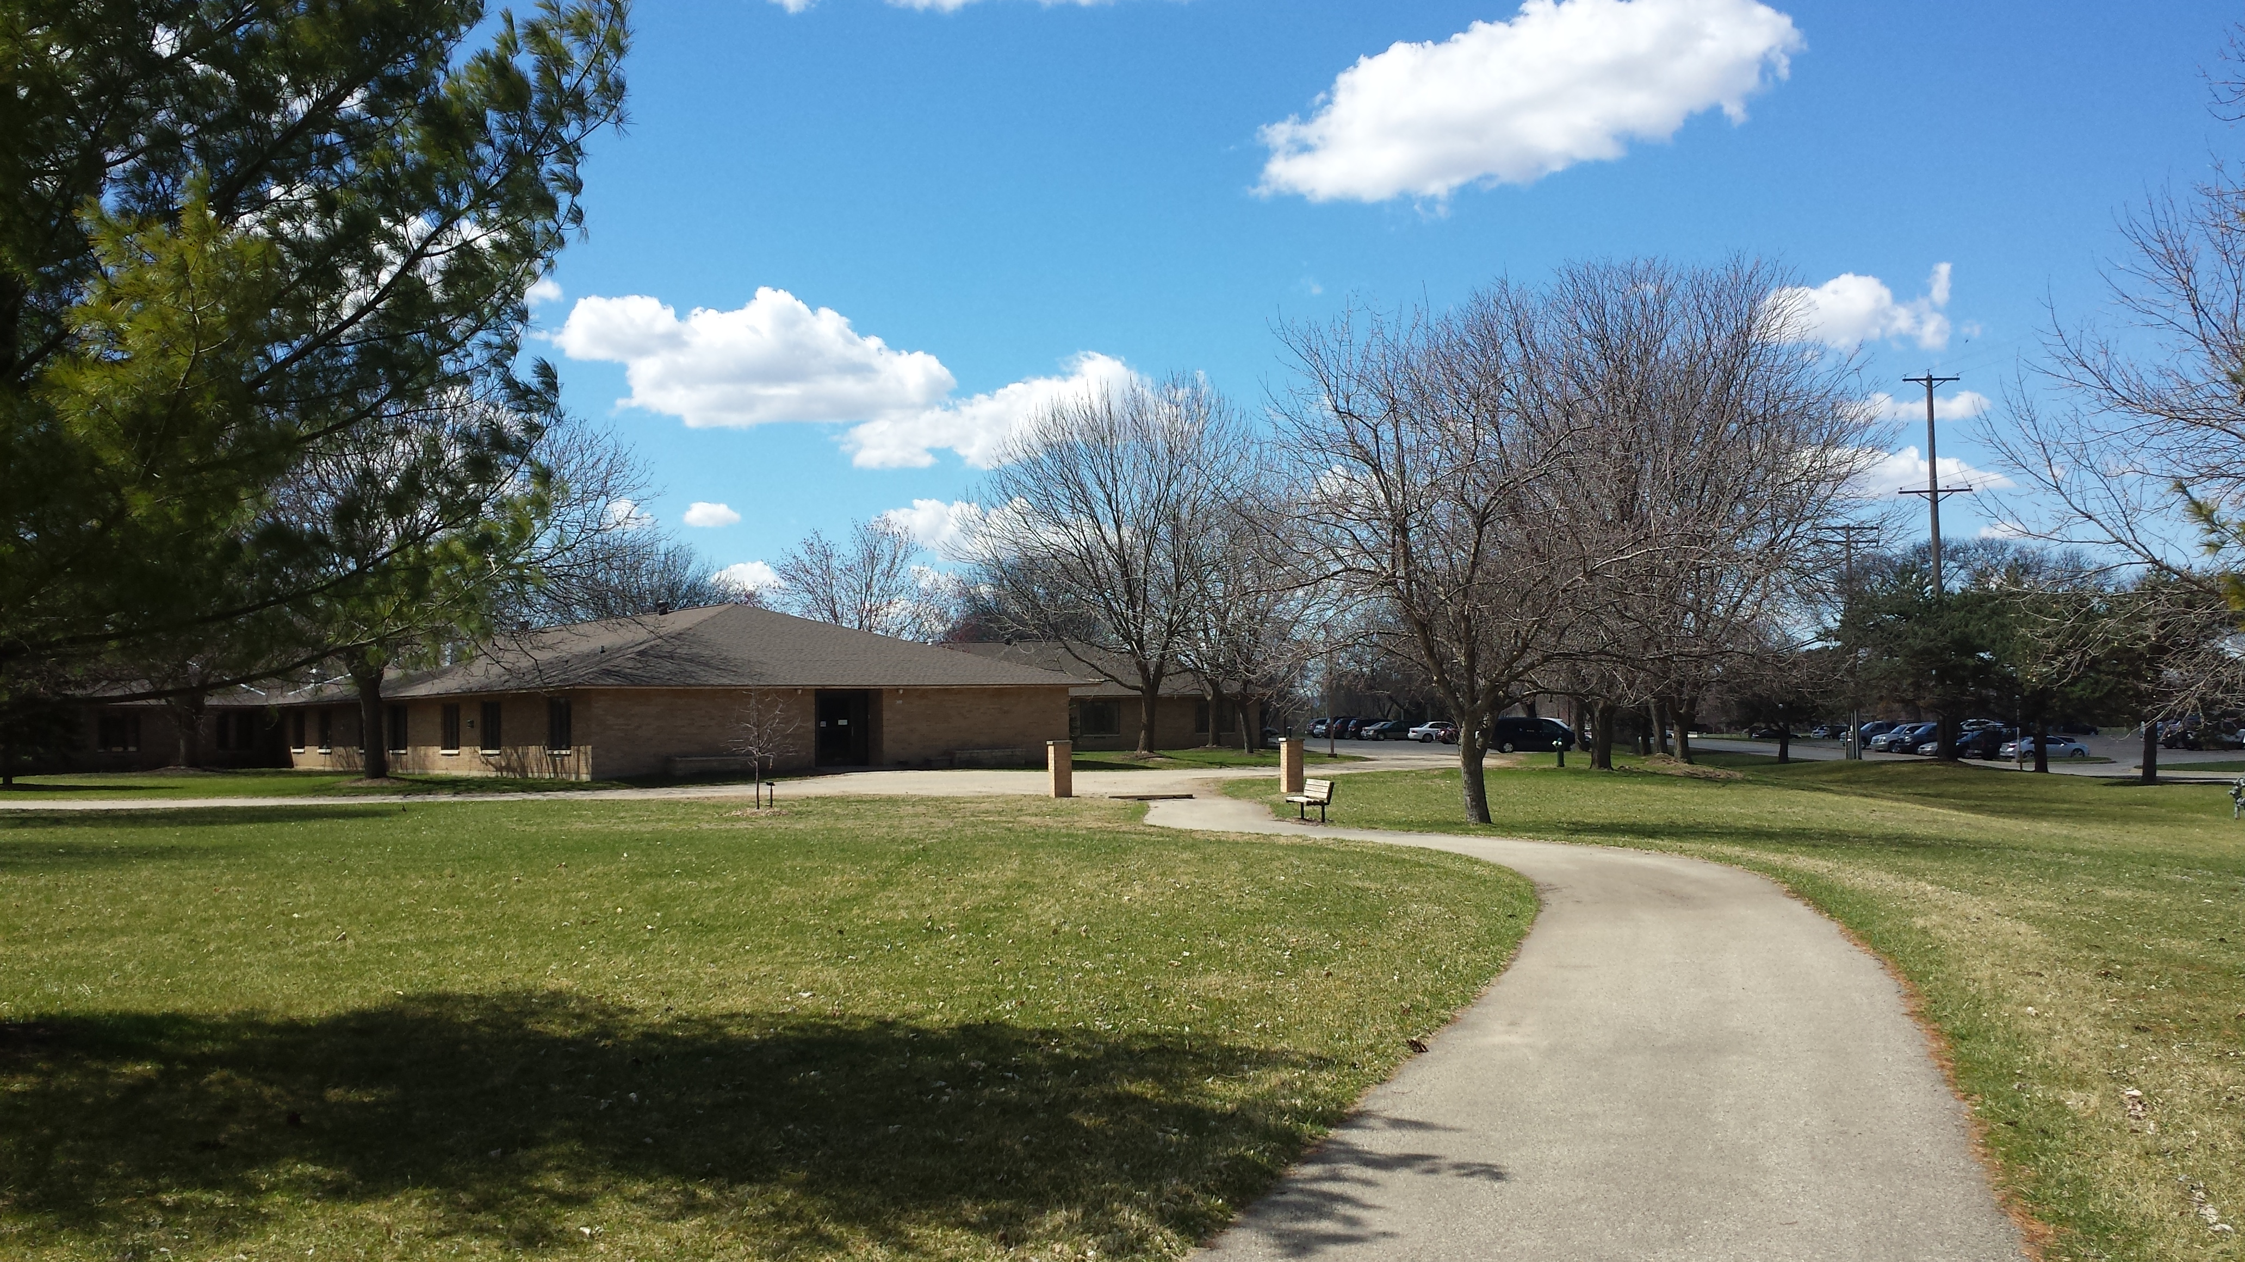

TOWN HALL
FAMILIES
January 2025

Slide 2
AGENDA
Introductions of HV staff
Campus model today and future state
Additional services on our campus
Hillview Project update-
Next Steps / Construction Timeline
Notes:
Thank you to those who were able to join live
RECORD
Introductions

Slide 3
Hillview’s current Model
10 Bed The Oaks Nursing home
Do you know what an Assisted Living is?
30 Residential Care Apartment Complex (RCAC) Hillview Terrace (long term)
There are 3 different kinds of Assisted Livings in WI.
-Adult Family Homes-LV
-RCAC-HV
-CBRF (Community Based Residential Facility)
Carroll Heights—55 apartments Independent Senior Housing
Hillview-Skilled Nursing Care 60 beds
Many needing long term care needs and would be served more appropriately in CBRF
Notes:
Triangle showing services we currently offer. Trend is LTC facilities show a decrease in SNF beds due to becoming more home like and less institutional. AL facilities are an option today that we didn’t have 30 years ago. This model also shows a missing piece to our continuum. Between the LV and HV campus we have a full continuum. Many people leave our campus because we are missing that middle level of care service.

Slide 4
Hillview Campus Future State
LONG TERM CARE
SNF
Hillview (26) The Oaks (10)
Short stay
30 Residential Care Apartment Complex
Hillview Terrace- Long term
EVERGREENS CBRF – 35 beds long term
EVERGREENS CBRF- 4 beds dedicated to DCSU short stay Dementia Crisis stabilization Unit – individuals with dementia/crisis (28 days short term)
Independent Senior Housing
Carroll Heights (55 units)
Any questions on the current or future model?
Notes:
Future of HV shows the addition of CBRF AL on our campus. In the end, we are caring for the same, slightly more, people in different areas on our campus by downsizing SNF and add the CBRF.
BOARD APPOVED model in our current home. Current home has more space than we need. CBRF service for either those with dementia or those with a higher care need and may not be able to go home, more care than an RCAC can provide.

Slide 5
Additional services on the campus
Intergenerational Day Center
  Child Care Center contracted out through the YWCA.
  Adult Day Center (day services only) for those with mild to moderate dementia. Start up provided through La Crosse County and transition to the YWCA over the next 2 years for an integrated program of both adults and children.
Supportive House
  Managed through La Crosse County Human Services
  Also known as Bridge Housing
  Supports those who have potential to be unsheltered
  Supports those who are already in a program with a case worker for support
  Staff on site via Human Services
  10 studio apartments
  Accessible only through the outside entrance.
Construction started September 9, 2024, on EAST

Slide 6
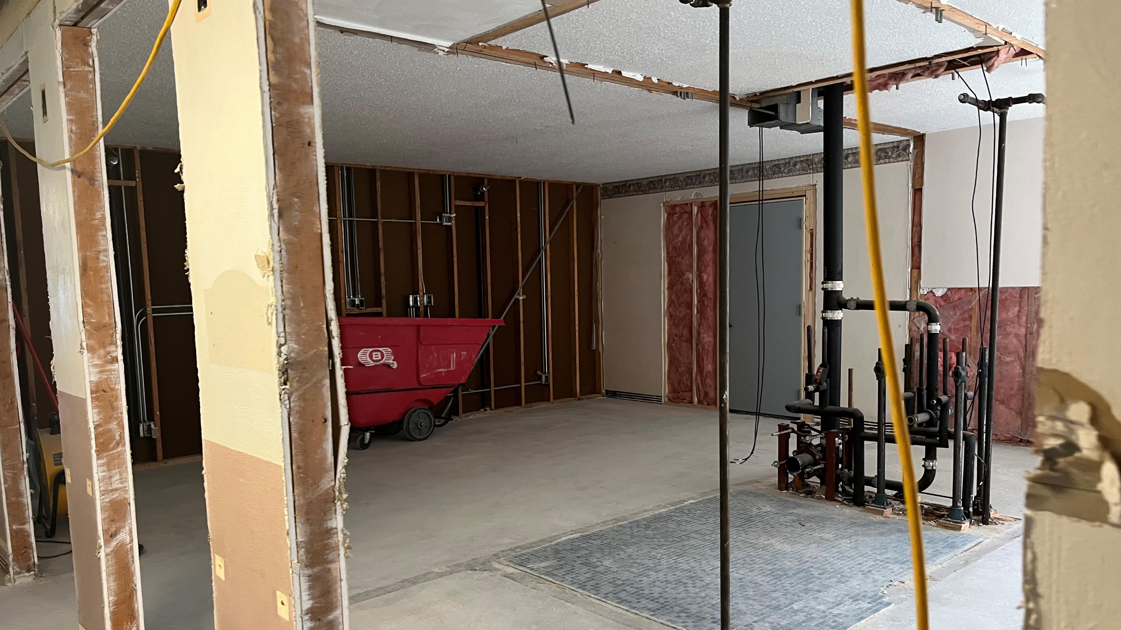
Project Update
RESIDENT MEETINGS-monthly progress updates, affects of construction on residents and tours!
SNF improvements due to additional grant funding
Letter sent end of November identifying what changes would be on the nursing home side.
Move Team reconvened
Residents began moving December 19th to the 100 hallway for approximately 2 months. Construction began on 900 hall January 3rd

Slide 7




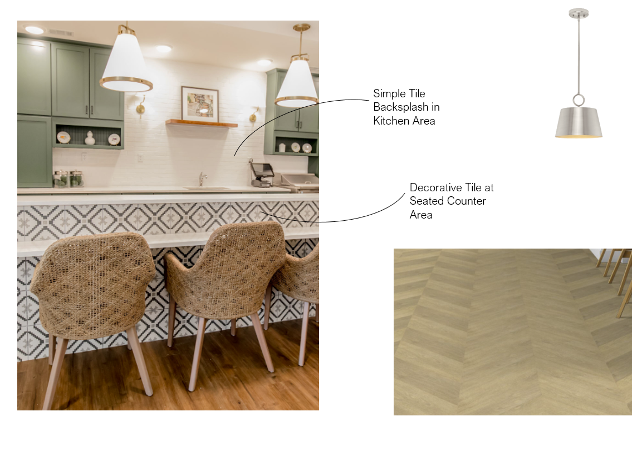
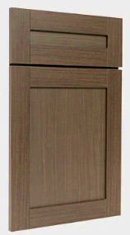





REMODEL of HILLVIEW SNF includes:
Abatement of old and installation of new flooring in resident rooms and hallways (excluding bathrooms)
Fresh paint in rooms and hallways
New heating and cooling systems in each room
New hallway lighting
New windows in all rooms
New country kitchen and dining room space
New furniture at the HUB
New Window shades- completed end of March
New nurse call system-completed end of project
New room lighting completed in end of March
New closets and bed side stands delivery end of March

Slide 8
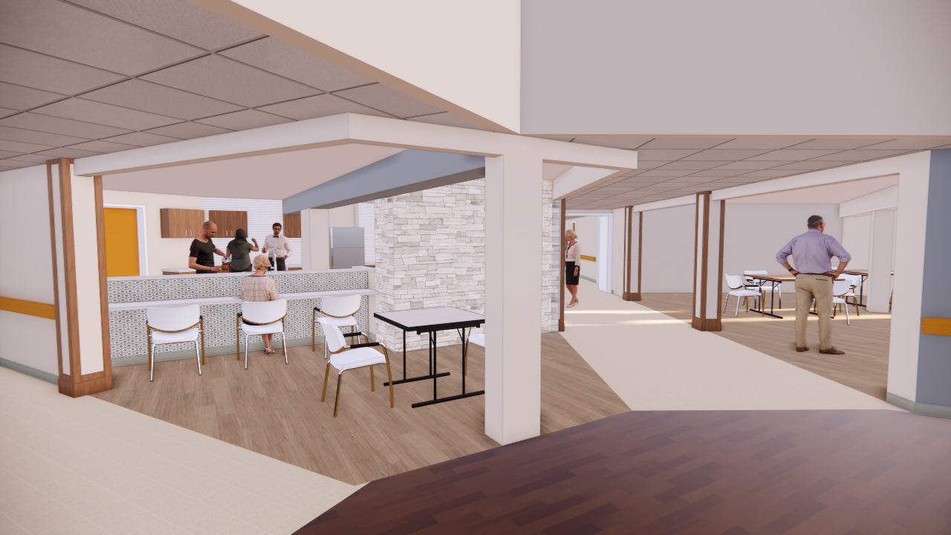
Chapel, Salon, Therapy and staff offices will be relocated to 600 hallway
End of Project, all rooms on 800 and 900 will be private rooms.
2 new SPA rooms on SNF and 1 on The Oaks

Slide 9
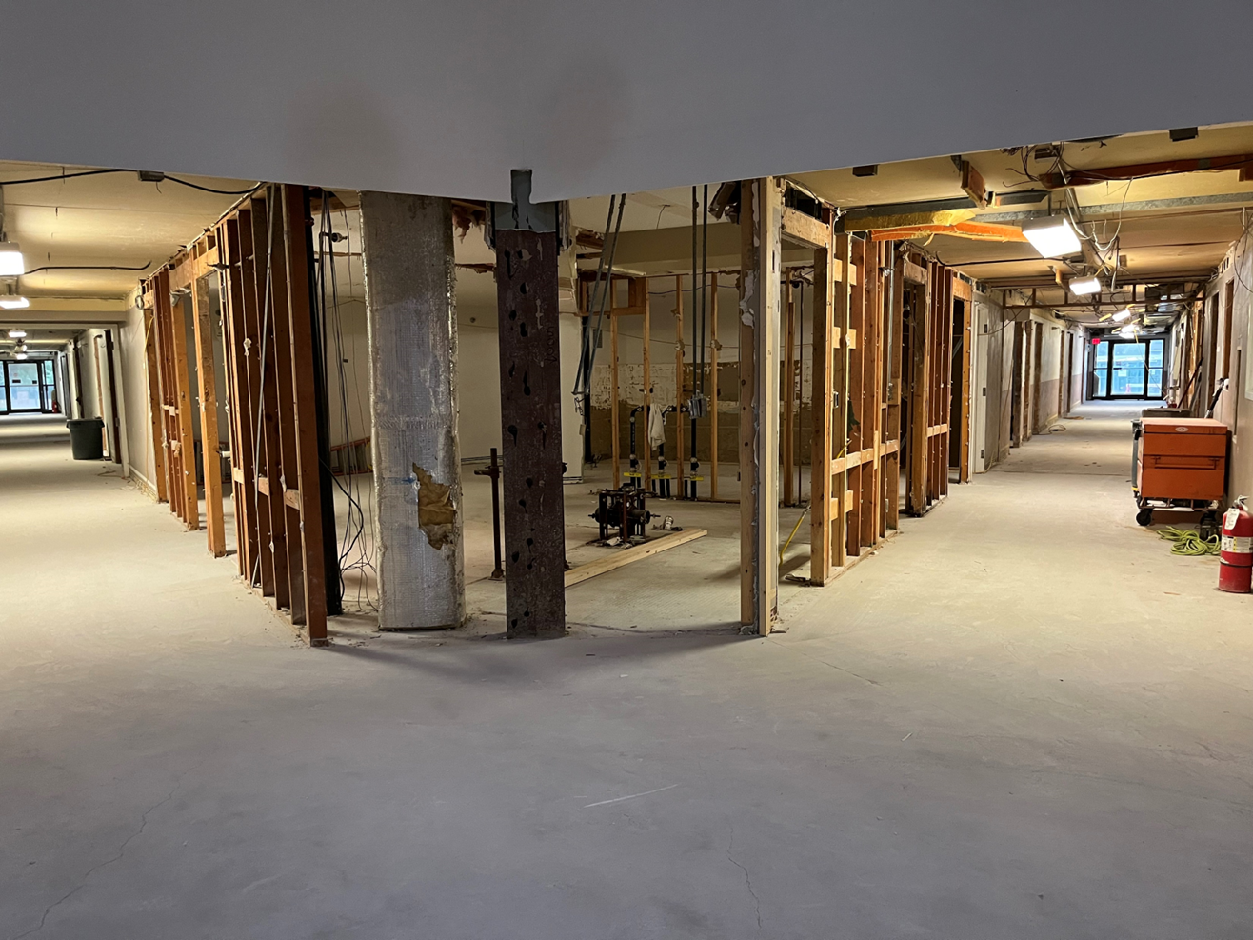

Slide 10
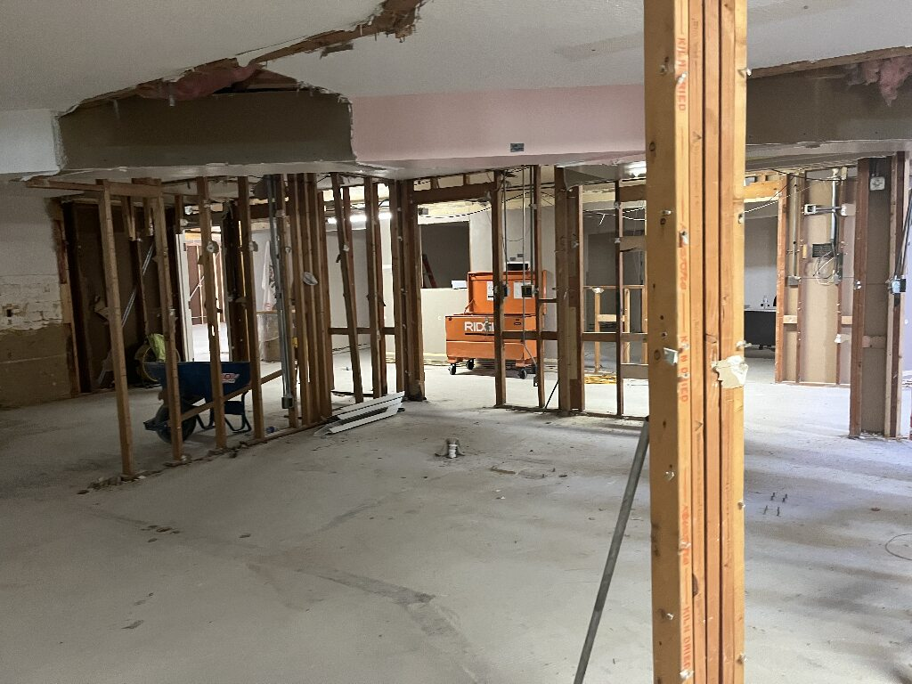

Slide 11
Additional CHANGES
Nurse Chart Room is now located down the main hall just past the 1000-day room
CNAs who are stabilized on 900 moved with the residents down to 100 and have a room across the hall from the front desk for charting
CNAs who are stabilized on 600 will be charting at the HUB area.

Slide 12
EMERGENCY OUTLETS and Analog phone line
Every room in the EVERGREENS and in HILLVIEW will have an emergency outlet.
When power goes out and our generator kicks in, this outlet will work off our generator for those on oxygen, those who have air mattresses, etc.
We will no longer have an outlet for an analog phone line in every resident room.
This will be a change added to our handbook this year and wanted to share with families and staff as we move forward. A letter will go out with this change to families.
There will continue to a be a phone on every hallway that will be a wifi phone for residents without a personal phone to use in the privacy of their room.

Slide 13
RELOCATION PLANS – long term plan
Submit plans between April - May 2025.
There will be an INDIVIDUALIZED plan for each person who lives at Hillview
a RELOCATION PLAN for each resident. even if it is to stay in our Nursing Home. A plan is required for everyone.
Plan will involve continual weekly assessing of each resident’s preference, needs, and funding.
Purpose is to openly communicate so there are no surprises. Preferences and needs may change throughout this process
Many people are involved in discussions about best location for each resident. (Ombudsman, Relocation Specialist, Family Care representative, ADRC representative and HV representative and Resident/Family)

Slide 14
Thank you
  Next Meeting February 27, 2025
  3:30pm Virtually via TEAMS only

