Slide 1
TOWN HALL
STAFF
February 2025

Slide 2
AGENDA
Meet our New ALS
Hillview Project update-
Website info
Next Meeting
Notes:
Thank you to those who were able to join live
RECORD
Introductions

Slide 3
INTRODUCTION to our plan
Hillview Health Care Center’s current model is heavily focused on skilled nursing care
It does not offer a full continuum of care options on its campus
To better align with the trends in long term care for future sustainability,
Hillview campus will decrease their number of licensed skilled beds from 60 to 26 by the end of 2025.
Downsizing of licensed nursing home beds began in January with gradual decreases until the 4th quarter of this year.
There is a plan for a gradual reduction in workforce to align with gradual decreases in census.

Slide 4
ASSISTED Living Supervisor
Please Welcome Joyce Ngwe,
Joyce oversees:
The Evergreens
Hillview Terrace
Carroll Heights

Slide 5
Hillview Project update
The transitioning of moving those on 100 hall back to their home on 900 has been delayed at least until first part of April.
The Oaks; One resident has been accepted to an Adult Family Home on the LV Campus.
We continue to look for placement for the one remaining resident

Slide 6
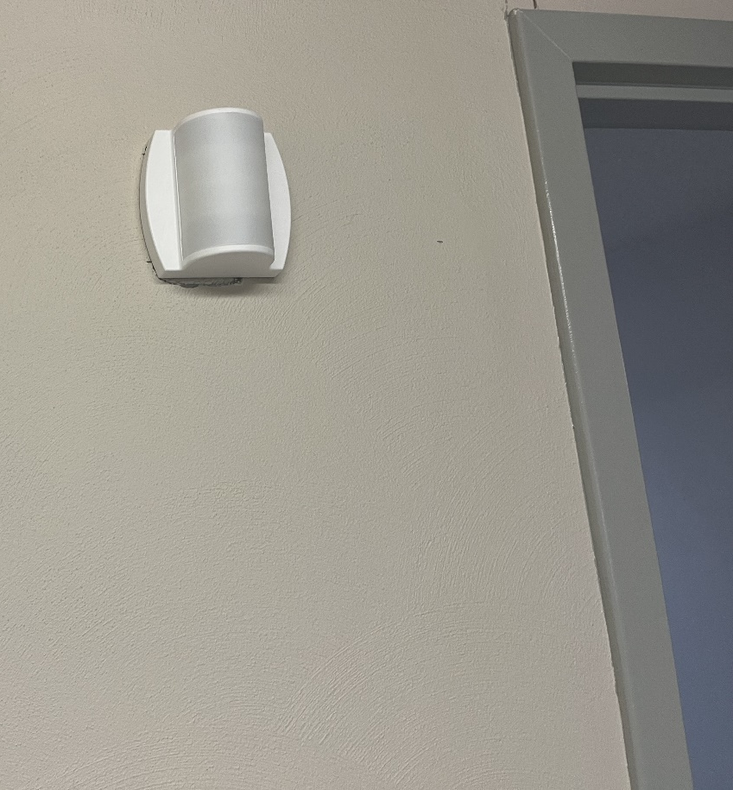
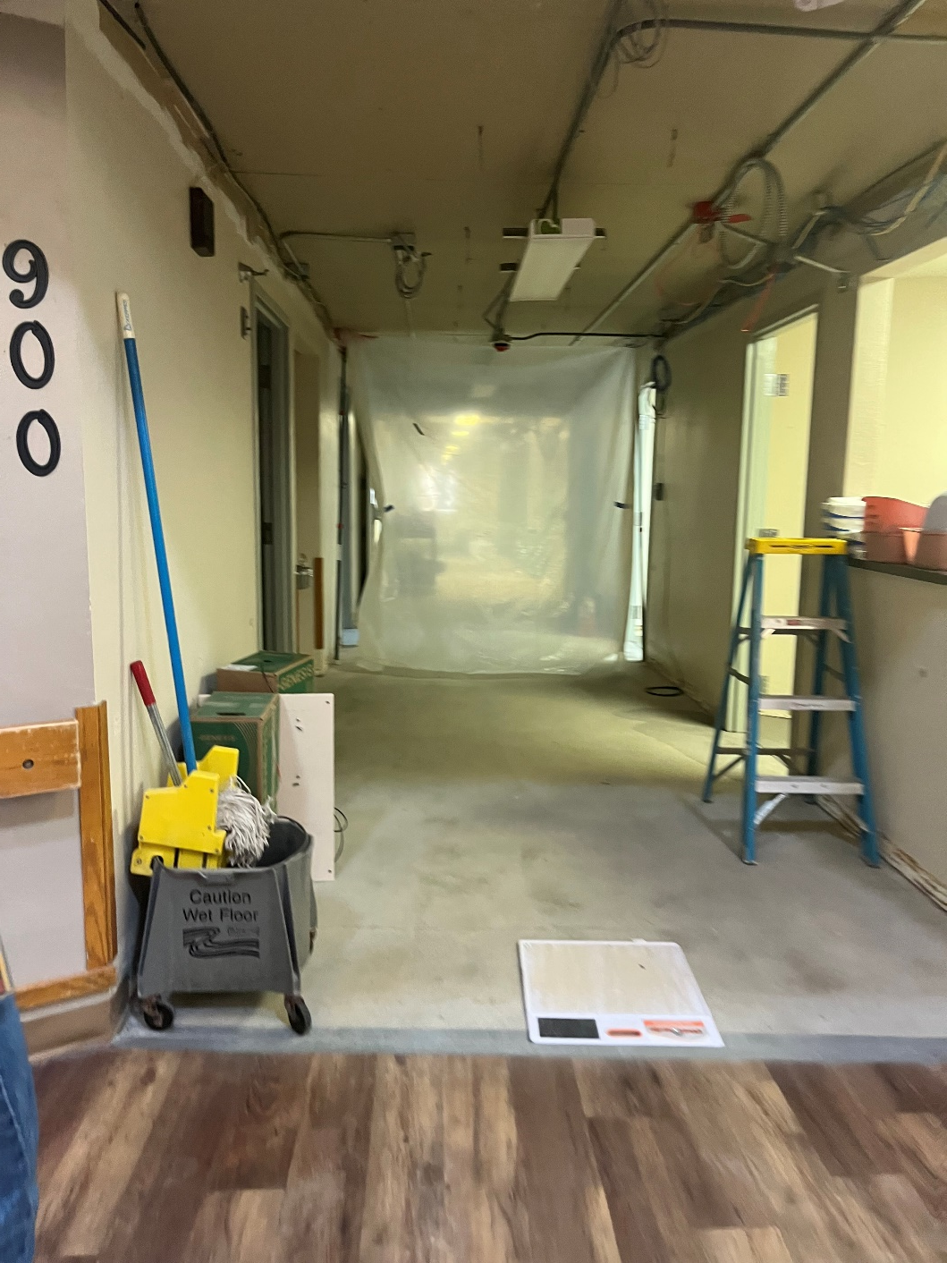
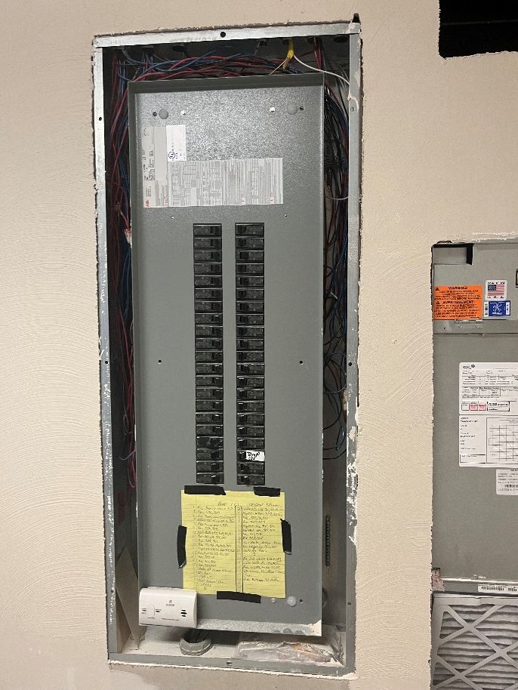

Slide 7
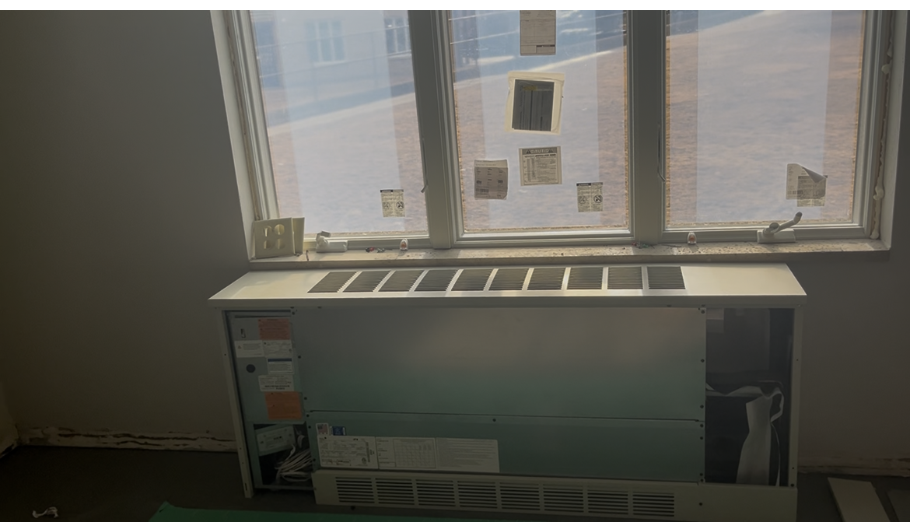

Slide 8
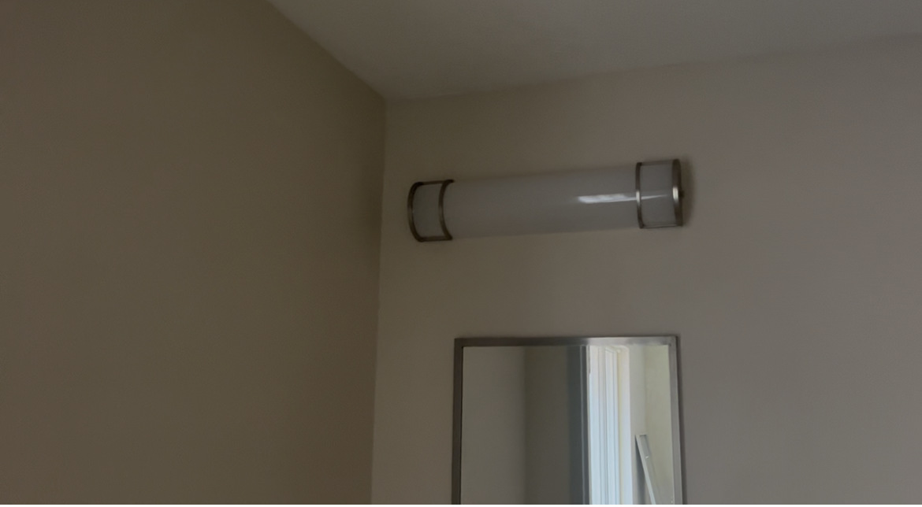

Slide 9
Med Room on 900.MOV
https://lacrossecountyorg-my.sharepoint.com/:v:/r/personal/kkramer_lacrossecounty_org/Documents/Desktop/project%20photos/900%20hall/Resident%20room.MOV?csf=1&web=1&e=Ih0DXr

Slide 10
HILLVIEW WEBSITE
Hillview
www.Lacrossecounty.org/hillview
View these presentations
View Family Newsletter
Notes:
A county wide training that was completed by all dept heads and supervisors downtown. All other staff, the training will be brought to you. We have 2 champions 1. Kim Haskey and 2. Carrie Mahlum who will organize and lead the completion of these trainings by all staff.

